Slide 1

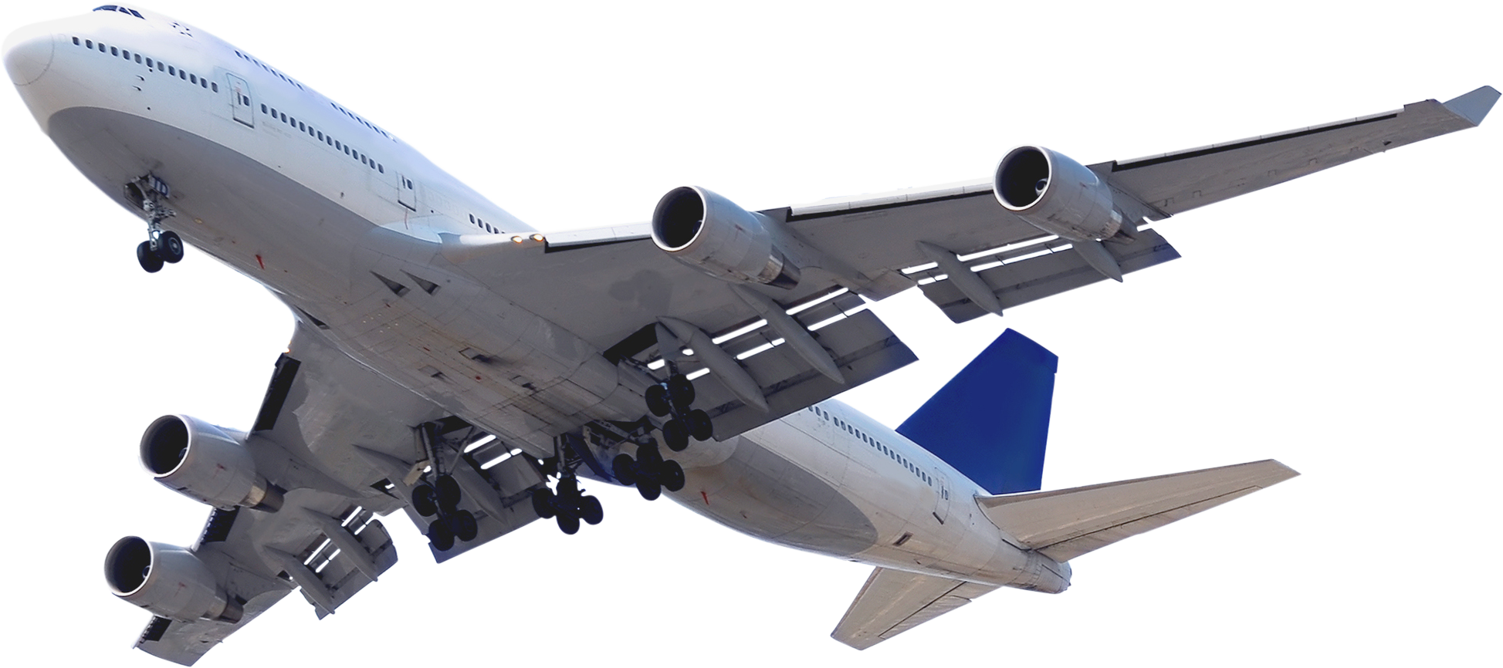

AirEase
“من تكتك لطيارتك....”
www.AirEase.com

Slide 2


AirEase
Home
About
Contact
THE PROBLEM
ONE WRONG MOVE
IS FATAL CAN COST
DOUBLE THE FLIGHT
PRICE CHANGES UP TO 3 TIMES A DAY
200+ million passengers <<< missed their flights >>>
02

Slide 3
AirEase
Home
About
Contact
SOLUTION?
AirEase
03

Slide 4
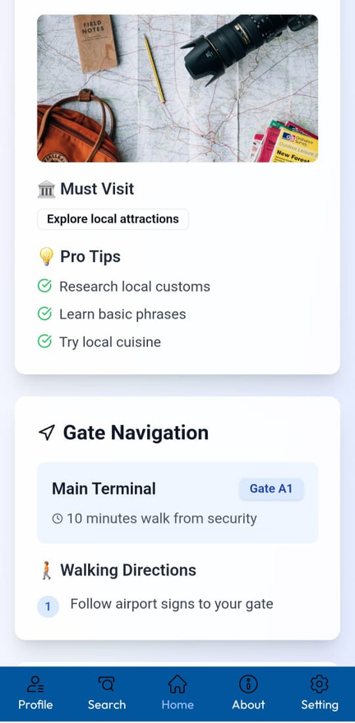
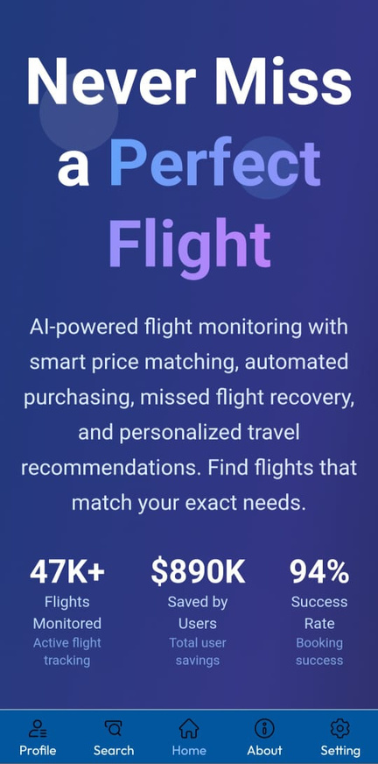
AirEase
Home
About
Contact
MVP FEATURES 🎯
01
AGENT FOR TICKET MATCHING
02
AI PLANNING
03
CONSTANT ALERTS & NOTIFICATIONS
04
INSTANT TICKET AQUIRE
05
MISSED FLIGHT HELPER
07

Slide 5
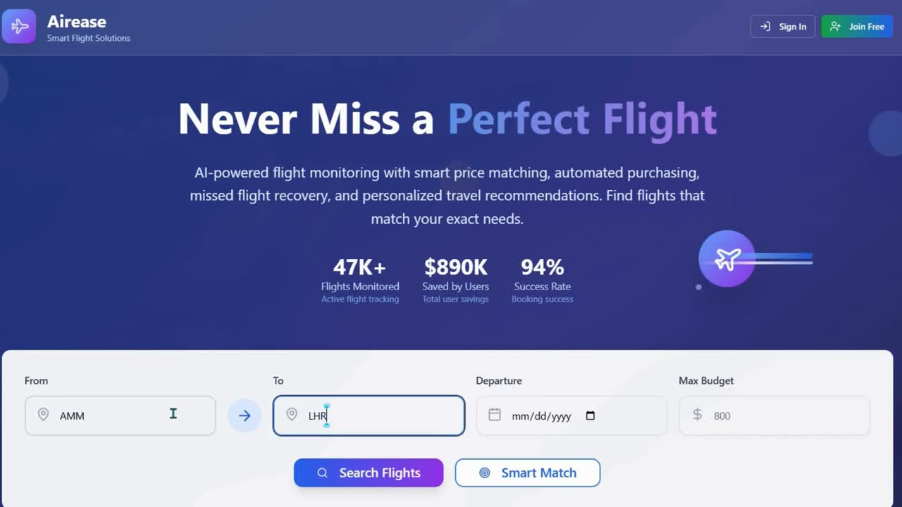

Slide 6

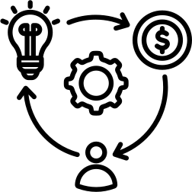
AirEase
Home
About
Contact
TARGET MARKET
BUSINESS MODEL
PER FLIGHT ADDED 5JDS
1.5–2 MILLION ACTIVE JORDANIAN OUTBOUND TRAVELERS
05

Slide 7

AirEase
Home
About
Contact
IMPACT
200JD SAVED YEARLY
more than 75% of flights wont be missed
08

Slide 8
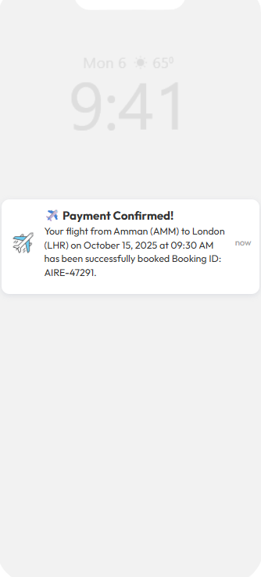
AirEase
Home
About
Contact
TECHNOLOGY STACK
Front-End
Next.js 14 + React 18 → Fast UI, dashboard, flight search.
Recharts → Visualize price trends & monitoring data.
Vertex AI
Gemini API (Google Generative AI)
Back-End
Predict flight delays, suggest optimal routes, and personalize recommendations.
Enables natural-language flight search, plain-English rule automation, smart itinerary summaries, and a conversational travel assistant—all in one engine.
Node.js (Next.js API routes) → Handles flight search, alerts, notifications.
MongoDB 6.6 → Stores flights, rules, watchlists, disruptions.
Zod Validation → Ensures clean, structured user inputs (rules, preferences).
09

Slide 9
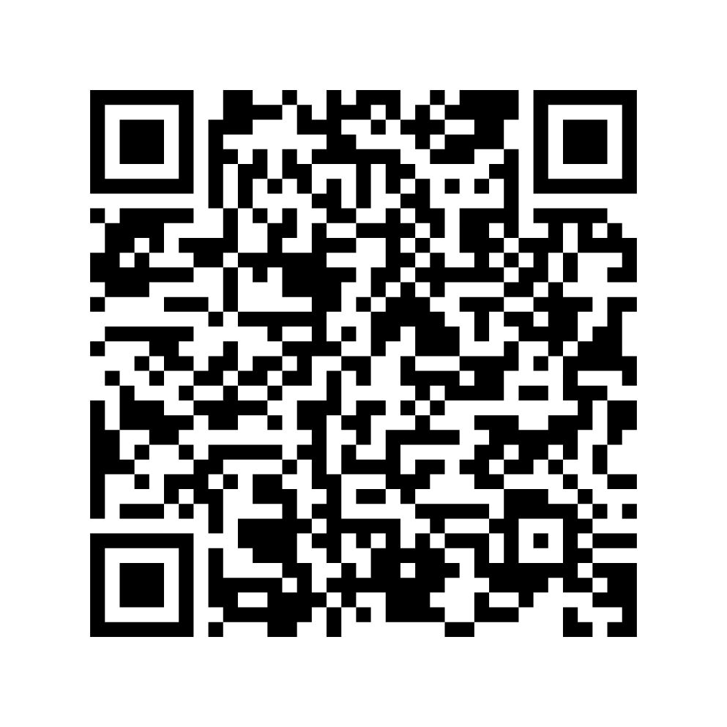

DOWNLOAD THE
APP

Slide 10
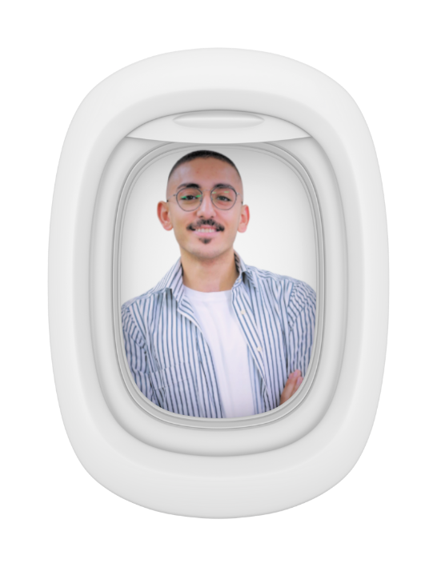
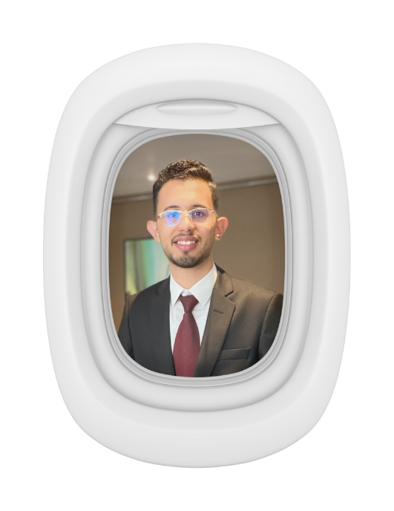
AirEase
“من تكتك لطيارتك....”
FULL-STACK DEV
AI ENGINEER

